Slide 1
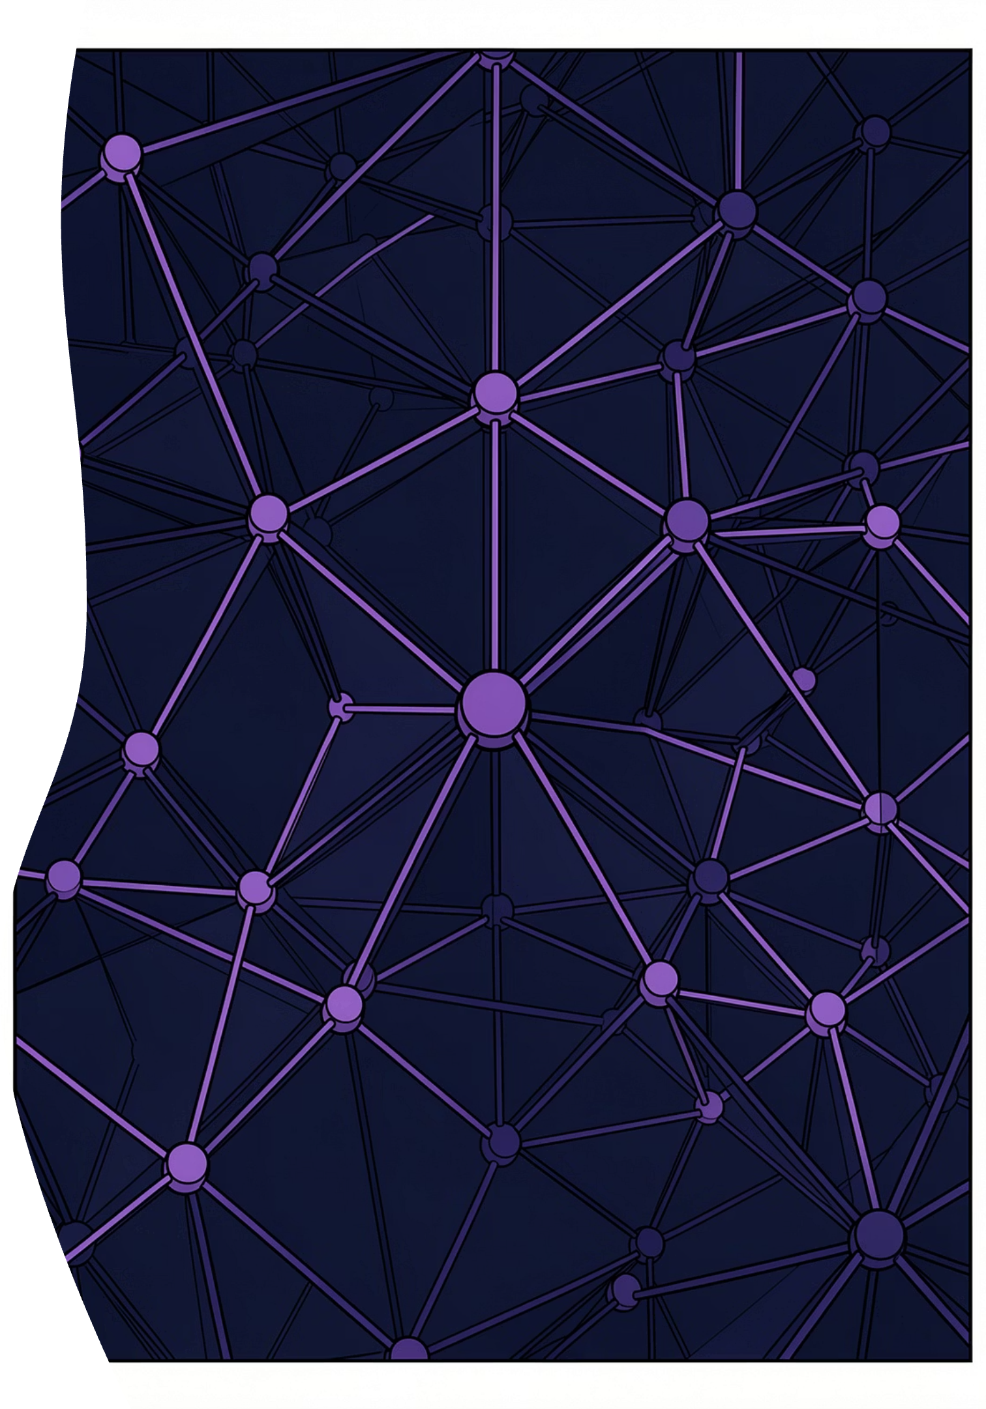
SWE30003 · WEEKS 1–4
Software Abstraction & Quality Design
System Architecture Synthesis — a structured review of verification, validation, UML modelling, quality attributes, and the foundational principles for mastering software complexity.

Slide 2
WEEK 1 REVIEW
Verification vs. Validation
Verification — Building It Right
Validation — Building the Right Thing
Are we conforming to the specification?
Does it solve the real-world problem?
Design compliance and static analysis
Code syntax and logic verification
Internal correctness against defined specs
Stakeholder expectations and usability
Real-world business problem resolution
Live environment performance and behaviour

Slide 3
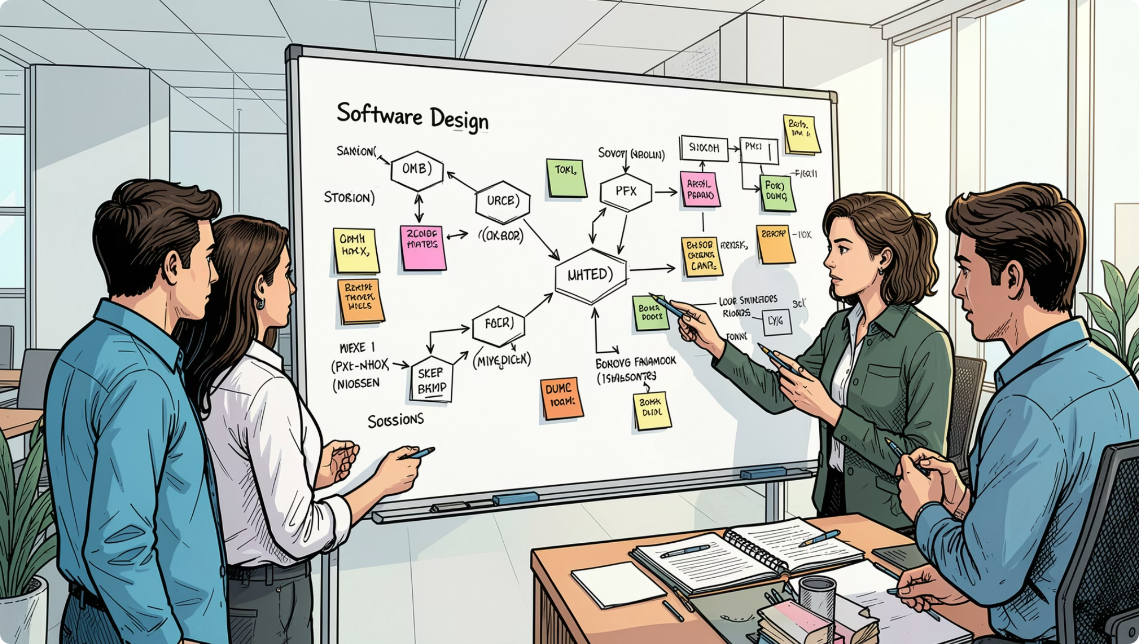
WEEK 2 REVIEW
UML Use Cases vs. User Tasks
UML Use Cases
Predefined system boundary. Separates human and computer interactions early. Focuses on system-level functionality with a clear scope.
Task Descriptions
Human–computer collaborative workflows. Describes the domain task without premature system splits, preserving real-world context before technical decisions are imposed.

Slide 4
WEEK 2 REVIEW
The Goal–Design Scale
Requirements exist at three levels of abstraction. Moving down the scale adds specificity — but risks premature design commitment.
Goal Level
1
Abstract business expectations — e.g., increase profitability by 5%
Domain Level
2
User activity outside the product — e.g., support recording cost calculations
Product & Design Level
3
Explicit system inputs, outputs, UI details, and internal tables

Slide 5
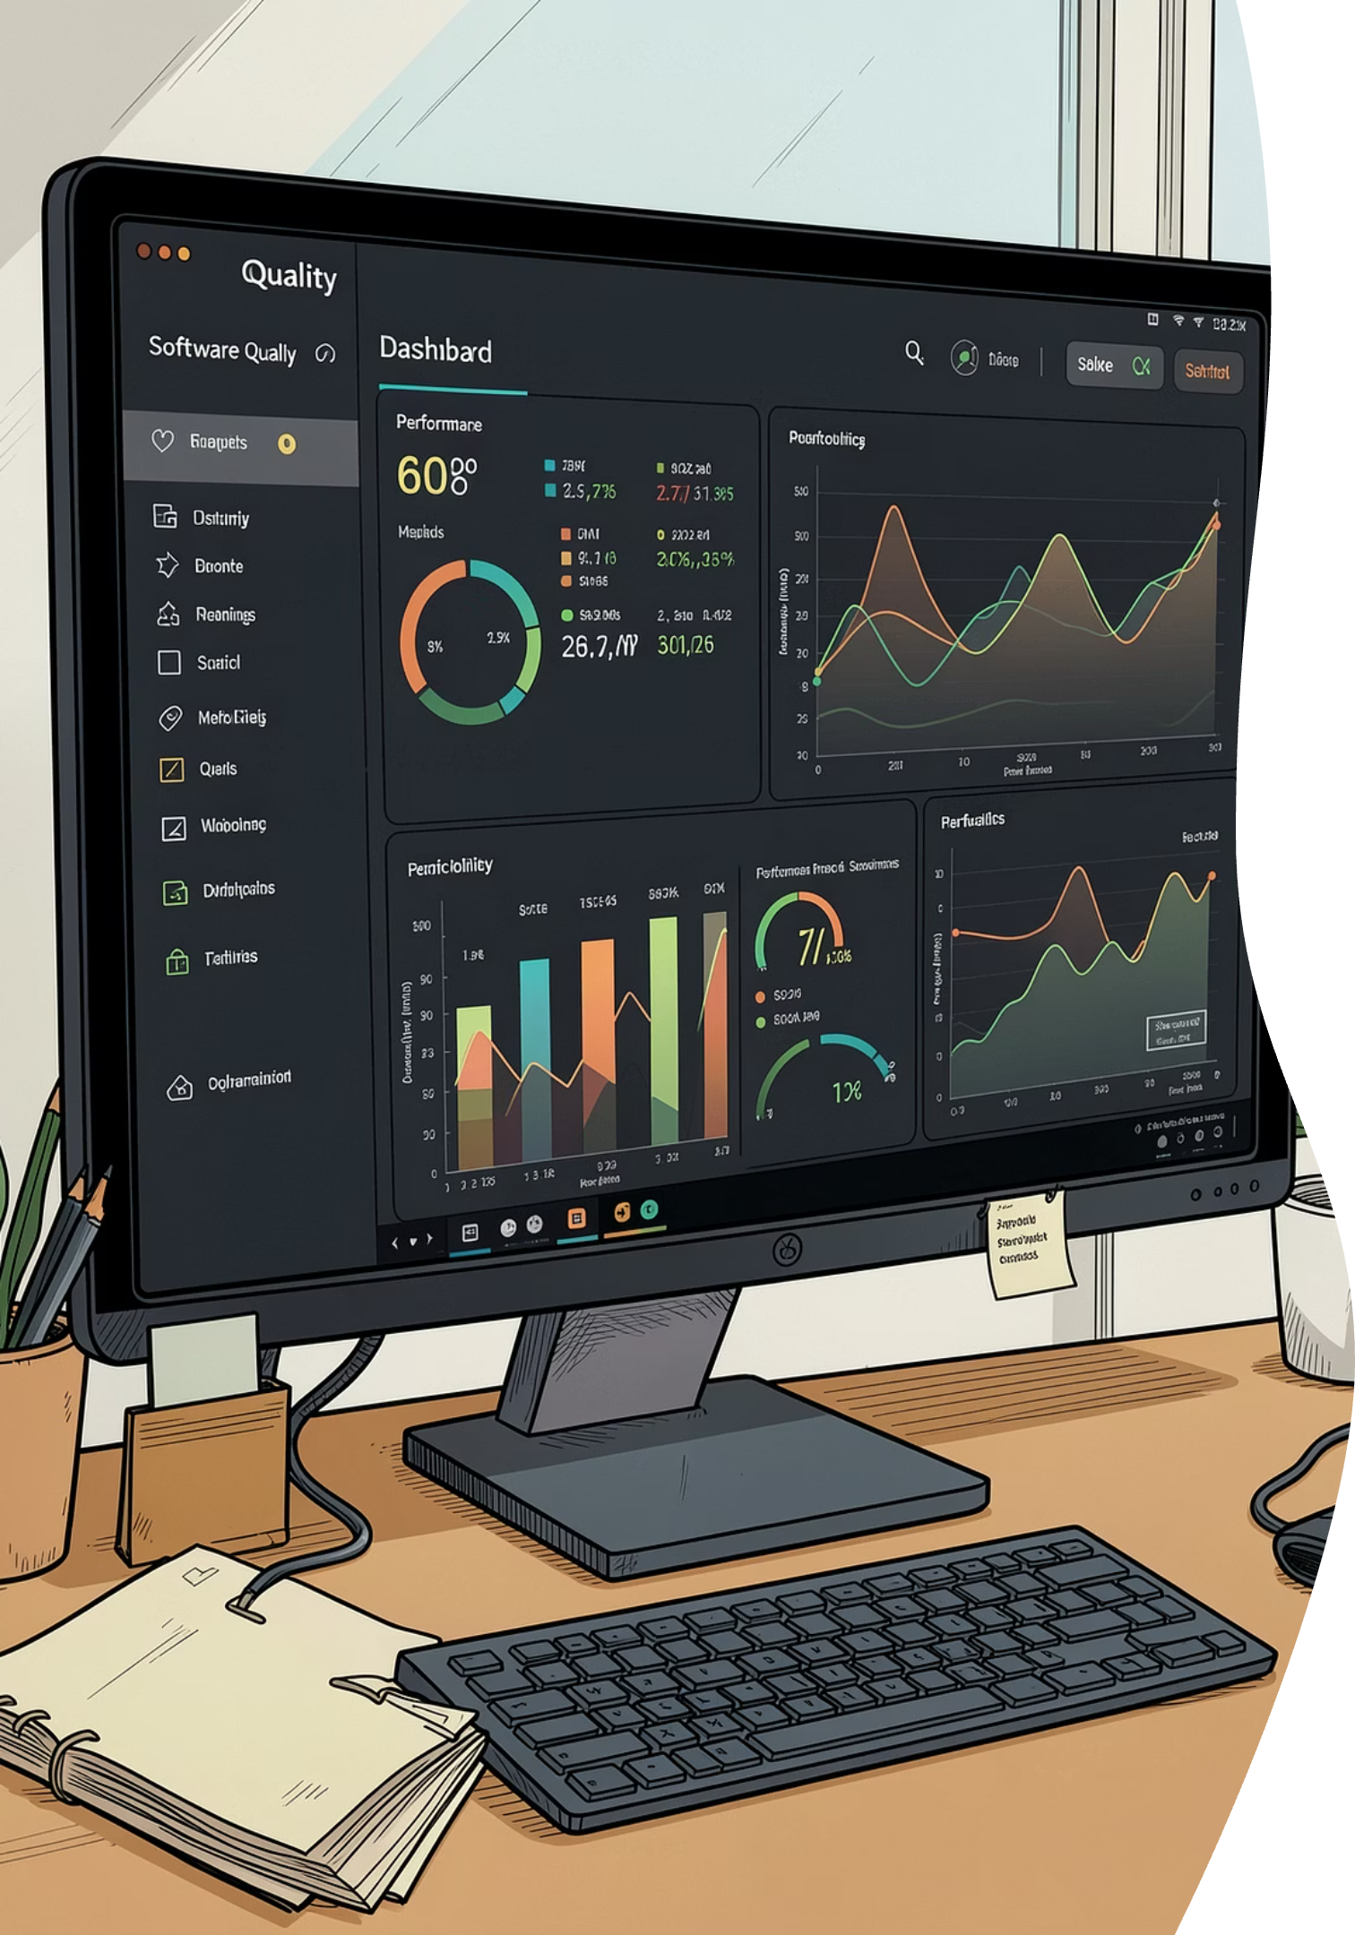

WEEK 3 REVIEW
SMART Quality Attributes
Vague — Unacceptable
"The system must have no delay and be highly portable."
Untestable and unverifiable — this is not a quality requirement.
SMART — Acceptable
"Latency must be ≤ 50ms at 300 characters/minute."
Verifiable, quantifiable, and testable. If you cannot write a test for it, it does not qualify as a quality requirement.

Slide 6
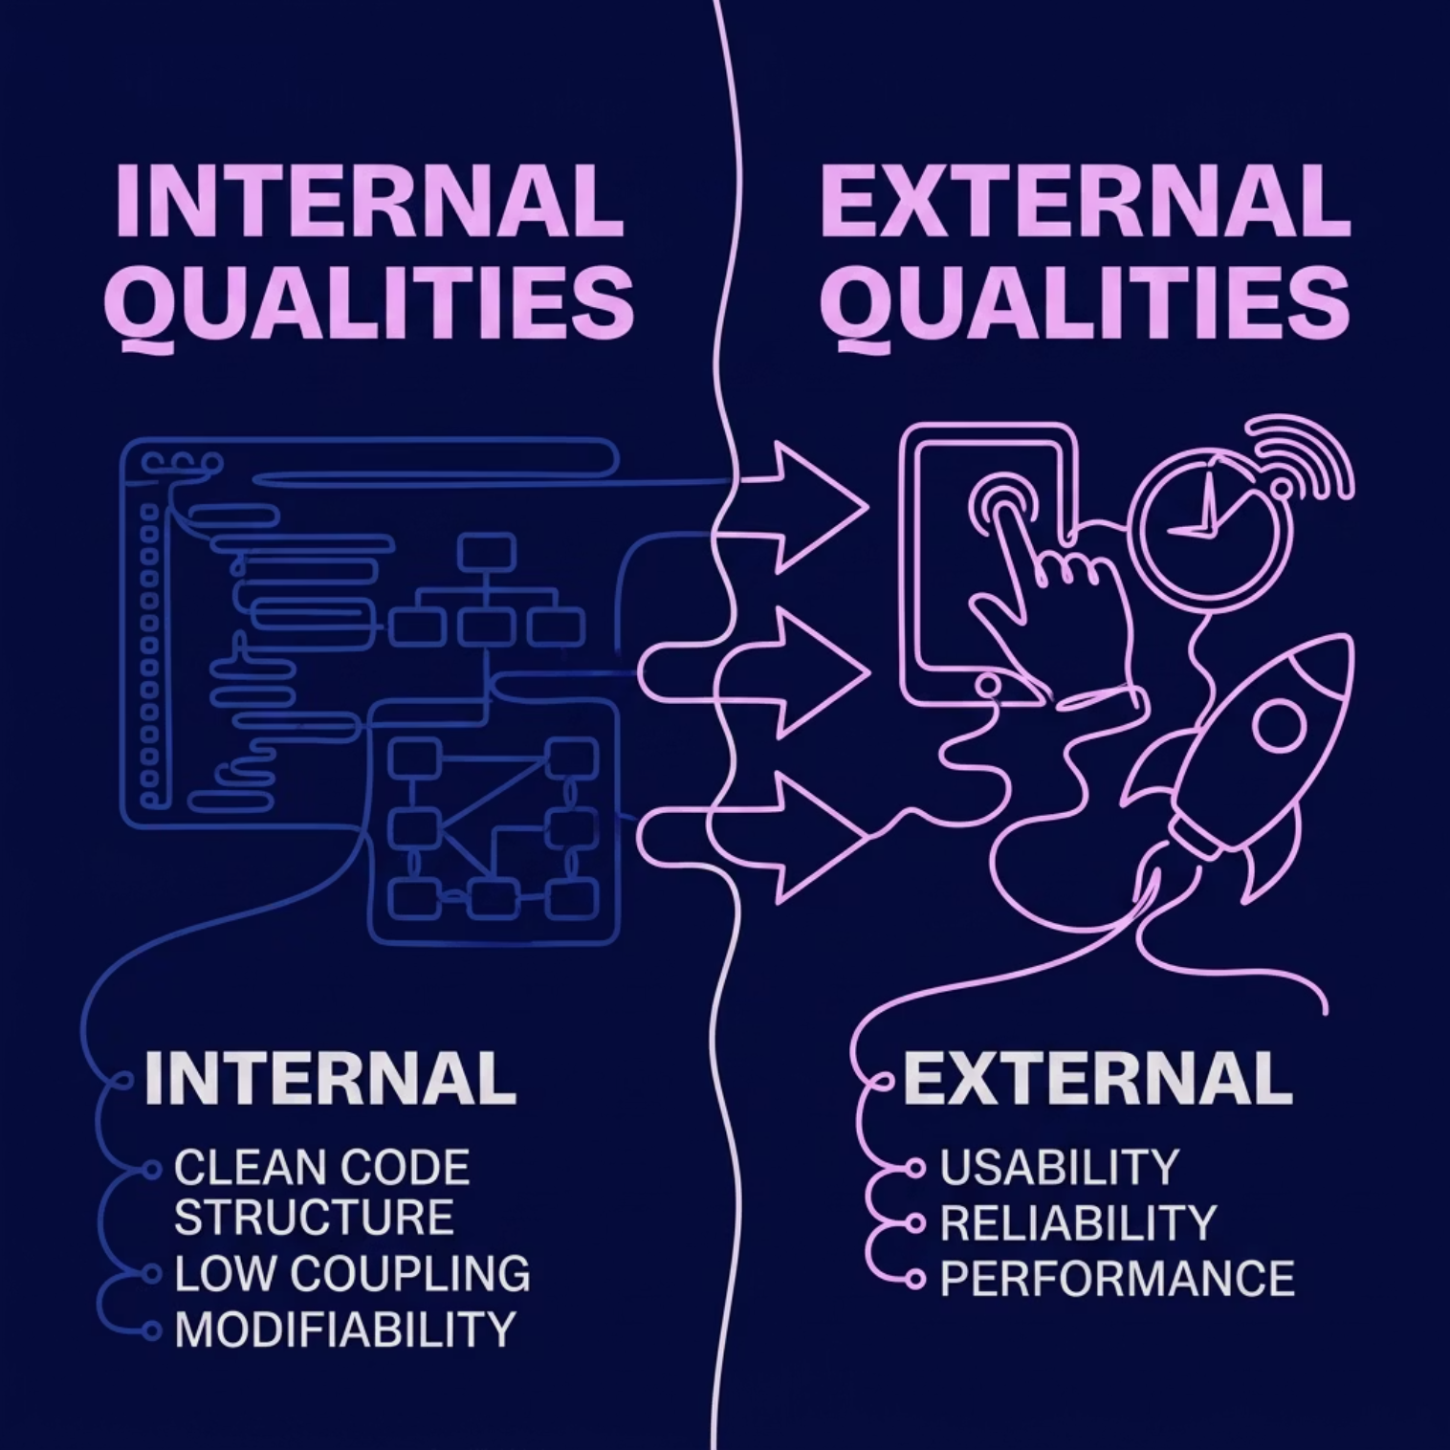
WEEK 3 REVIEW
Quality Tension & Trade-Offs
Internal vs. External Qualities
External qualities — usability, reliability, performance — are what users experience. They are driven by internal qualities: clean code structure, low coupling, and modifiability managed by developers.
Key Trade-Offs
Caching improves performance but reduces data consistency
Modifiability and Security are frequently in tension

Slide 7
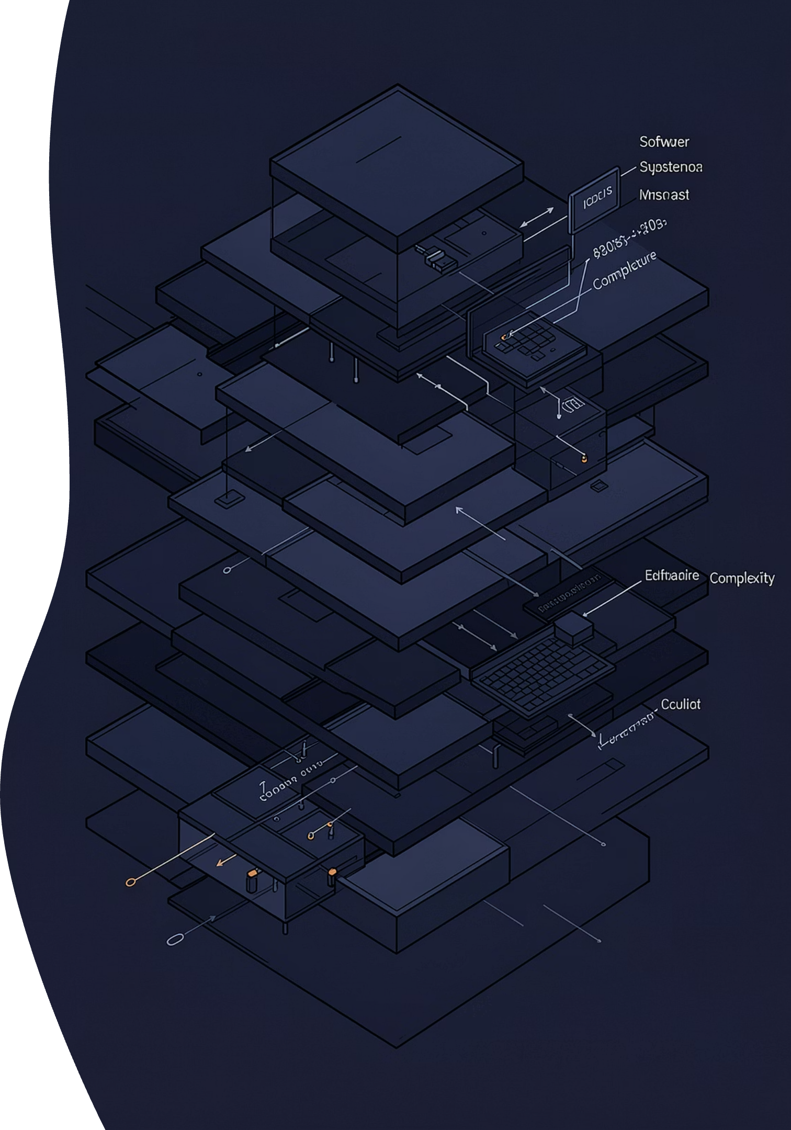
WEEK 4 LECTURE
Mastering System Complexity
Complexity is inherent in software — it can only be mastered, never destroyed. Three foundational pillars make this possible.
Abstraction
Decomposition
Hiding irrelevant details to highlight essential properties
Splitting systems into manageable, independent components
Composition
Orchestrating interfaces and system interactions coherently

Slide 8
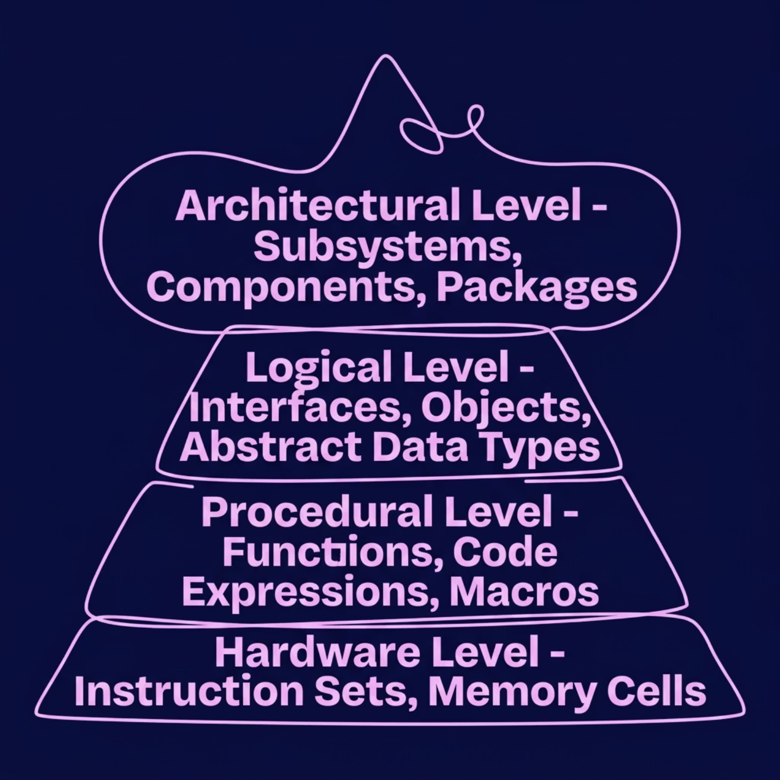
WEEK 4 LECTURE
The Software Abstraction Stack
Software operates across four distinct abstraction levels. Each layer encapsulates complexity and exposes a controlled interface to the layer above.
Architectural: Subsystems, components, packages
Logical: Interfaces, objects, abstract data types
Procedural: Functions, code expressions, macros
Hardware: Instruction sets, memory cells

Slide 9
WEEK 4 LECTURE
Abstractions Beyond Code
System Models
Architectural Blueprints
Design Patterns
Domain models capturing real-world entity associations and shared vocabulary — the conceptual foundation before any schema is planned.
Shared understanding of processing elements and component interfaces, enabling consistent team-level design decisions.
Documented, recurring, standard software architectural templates that encode proven solutions to common structural problems.

Slide 10
CASE STUDY · SYNTHESIS
Hotel Domain Model & Key Takeaways
Domain Entities
Key Takeaways
Map Guest, Stay, RoomState, and Service to define specifications before planning database tables or schemas.
The Translation Bridge: Software design translates messy stakeholder requirements into clean, testable system abstractions
Design Vocabulary (Guy Steele): Great developers grow an expressive structural design language — they do not just write code
User Tasks Matrix
Real-world actions — discussing dates, verifying identity, handing keys — map to software responses: allocating rooms, processing bills, updating dirty room state.

